Slide 1
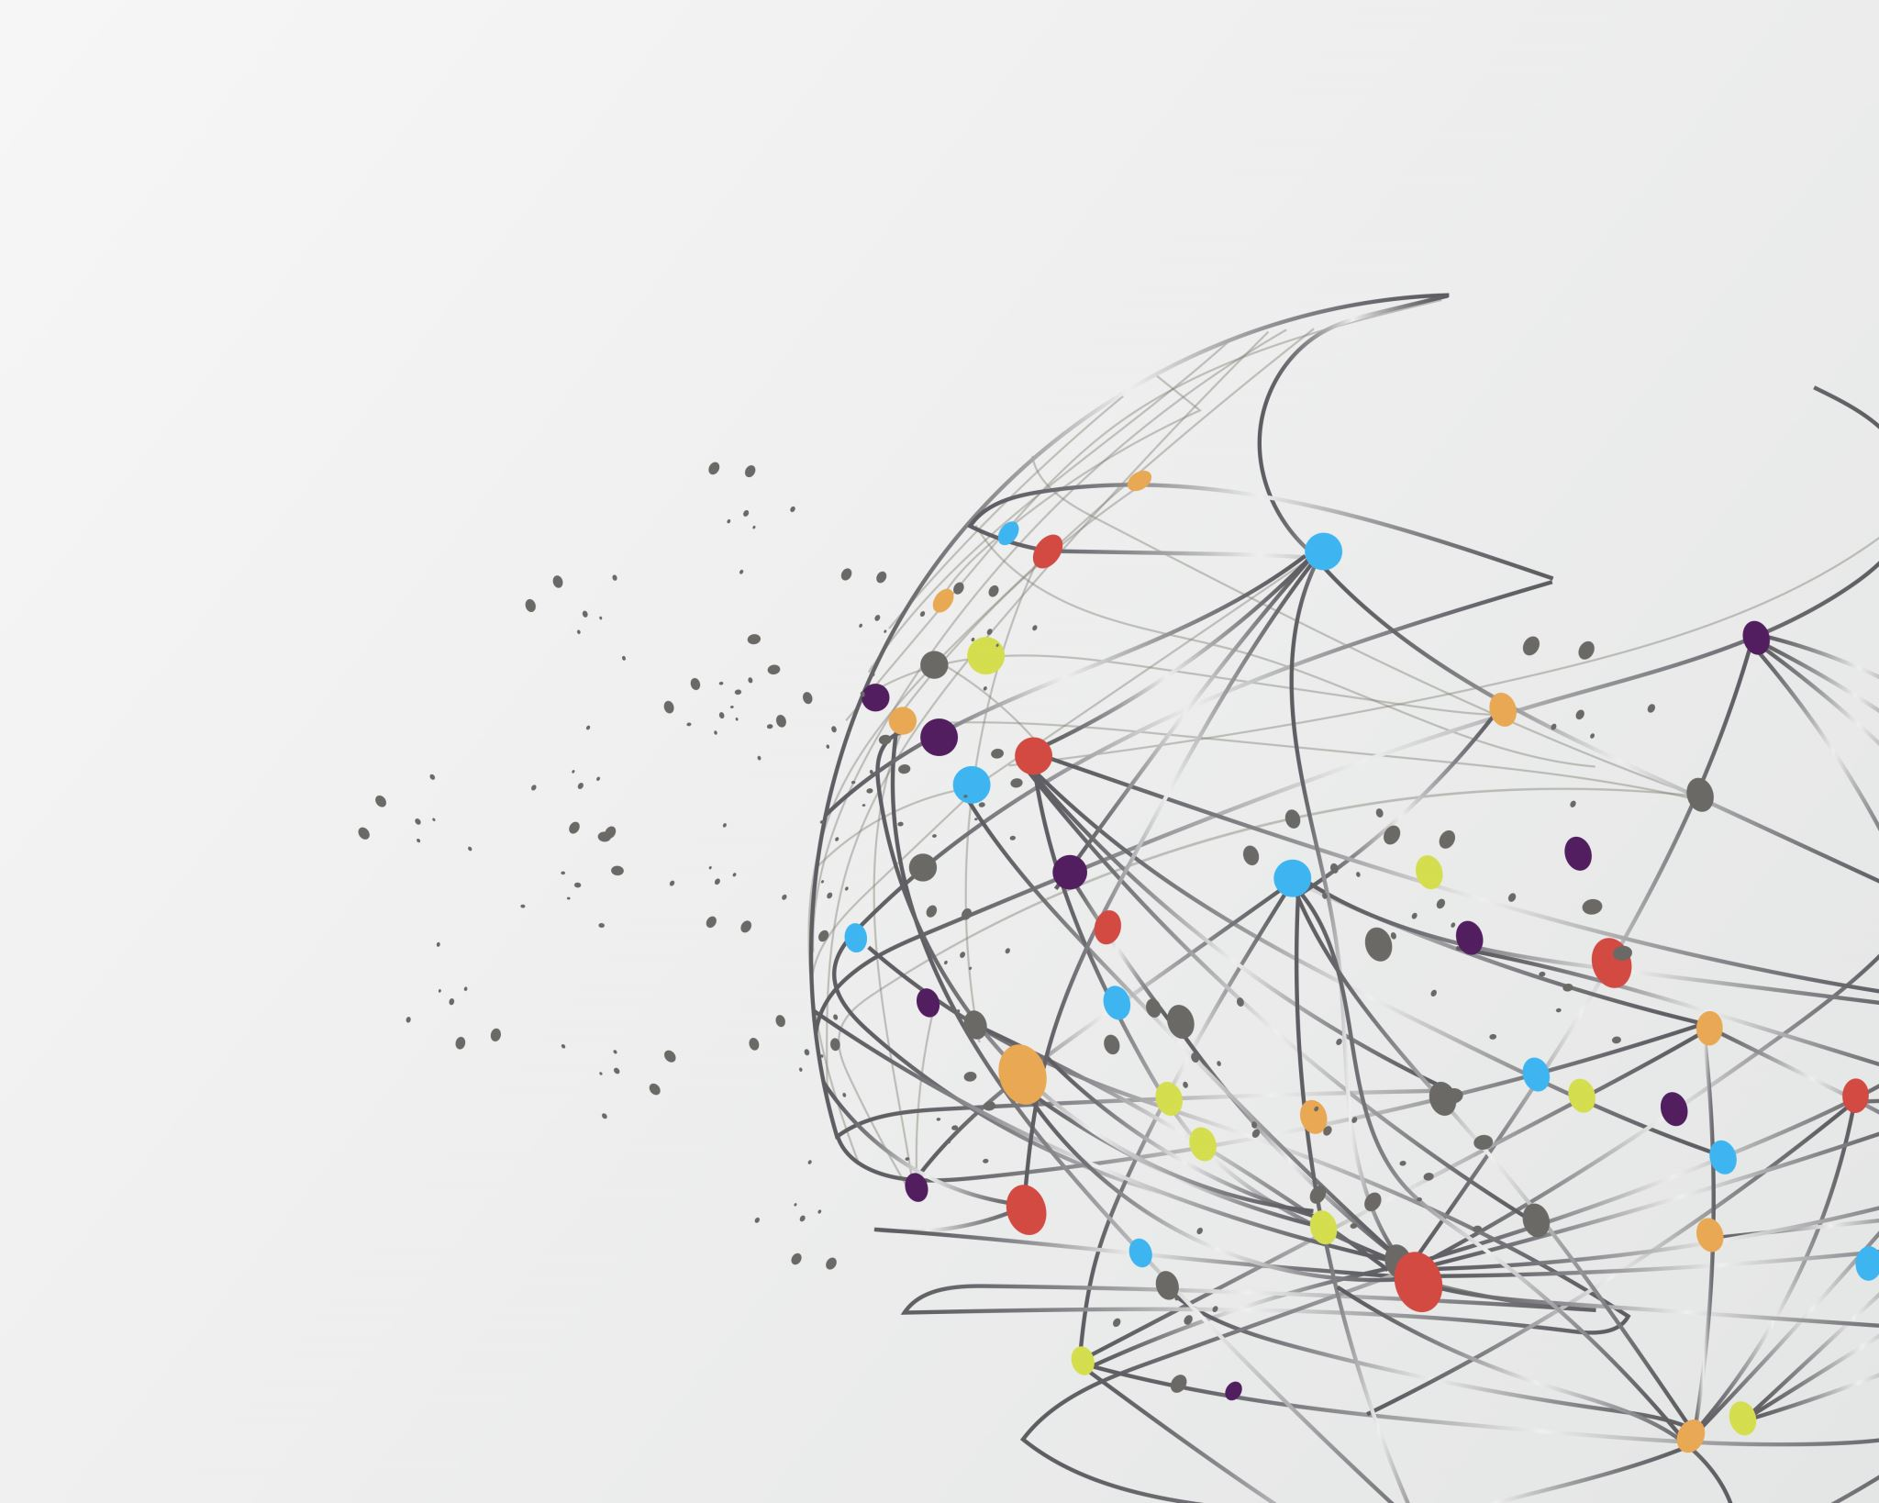
AI for ASL
Avnish Jadhav
Urvi Patel
Belton He

Slide 2
Purpose
Goals
Choosing a Neural Network
Choosing Models
Hyperparameters & Data
Takeaways
Challenges
Future Applications & Improvements
AGENDA

Slide 3
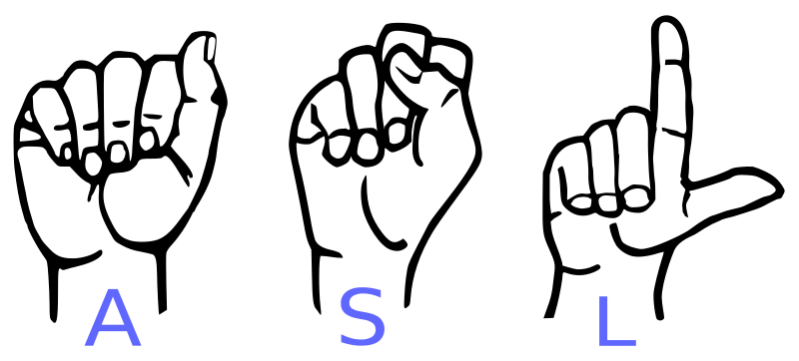
Our Purpose
More than 70 million deaf people around the world who use sign languages to communicate.
Spoken languages have electronic translators which are easily accessible, simple to use, and allow for quick and immediate translations between numerous languages.
But this technology does not accommodate signed languages.
Our team aimed to help bridge this gap by creating an American Sign Language Translator.
https://www.hrw.org/news/2019/09/23/without-sign-language-deaf-people-are-not-equal

Slide 4
Goals
What type of Neural Network was best for our project?
What are different types of models we could use?
What were some hyper-parameters we could change to improve the performance of our model? How does manipulating the data affect the outcome?

Slide 5
Choosing A Neural Network

Slide 6
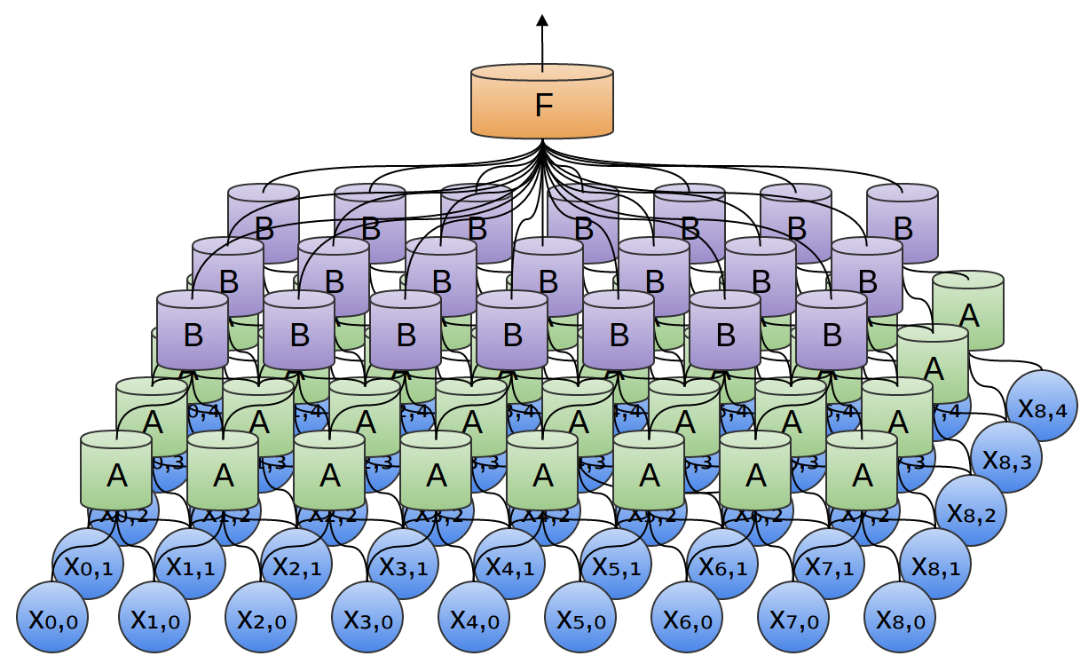
What is a Convolutional Neural Network?
Deep Learning algorithm that takes an input image and outputs a classification label.
http://colah.github.io/posts/2014-07-Conv-Nets-Modular/

Slide 7
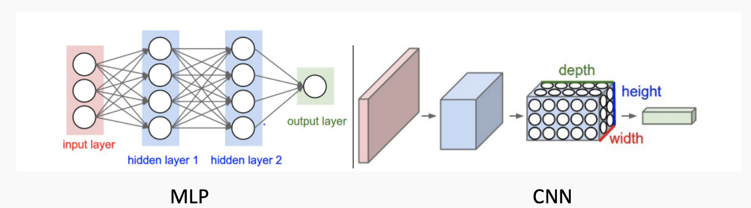
Convolutional Neural Network
Specifically designed to process pixel data
It’s best for 2D images
CNN breaks down an image into multiple groups of pixels by location, and only focuses on these individual groups.
https://towardsdatascience.com/simple-introduction-to-convolutional-neural-networks-cdf8d3077bac

Slide 8
Choosing Models

Slide 9
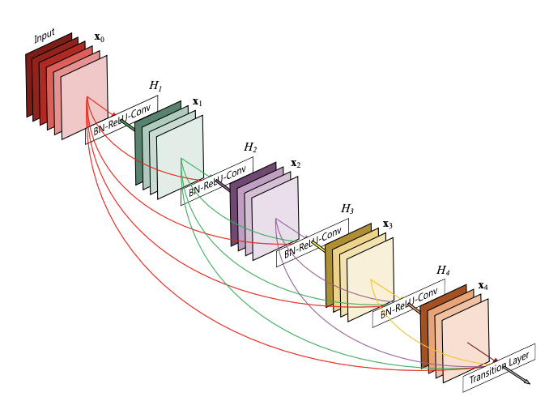
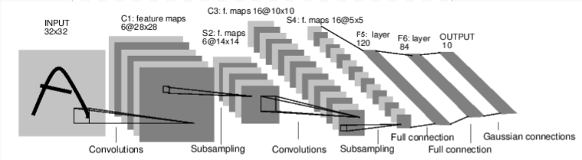
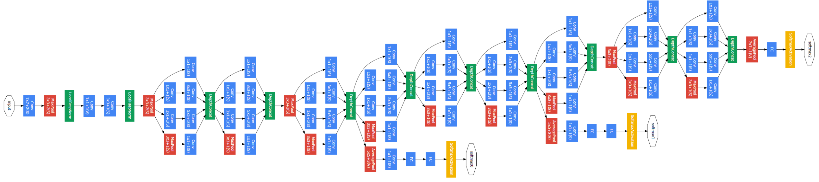
Models
Simple Classifier
DenseNet
GoogLeNet

Slide 10
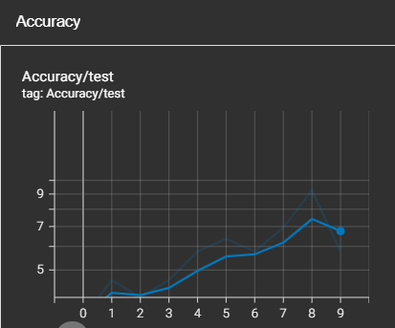
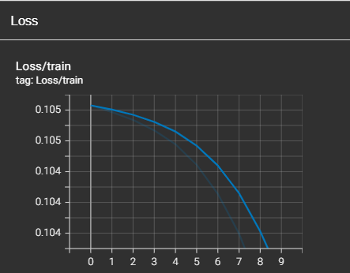
Simple Classifier
PyTorch Simple Classifier
We reached 7% accuracy and the loss decreased overtime, but poorly.

Slide 11
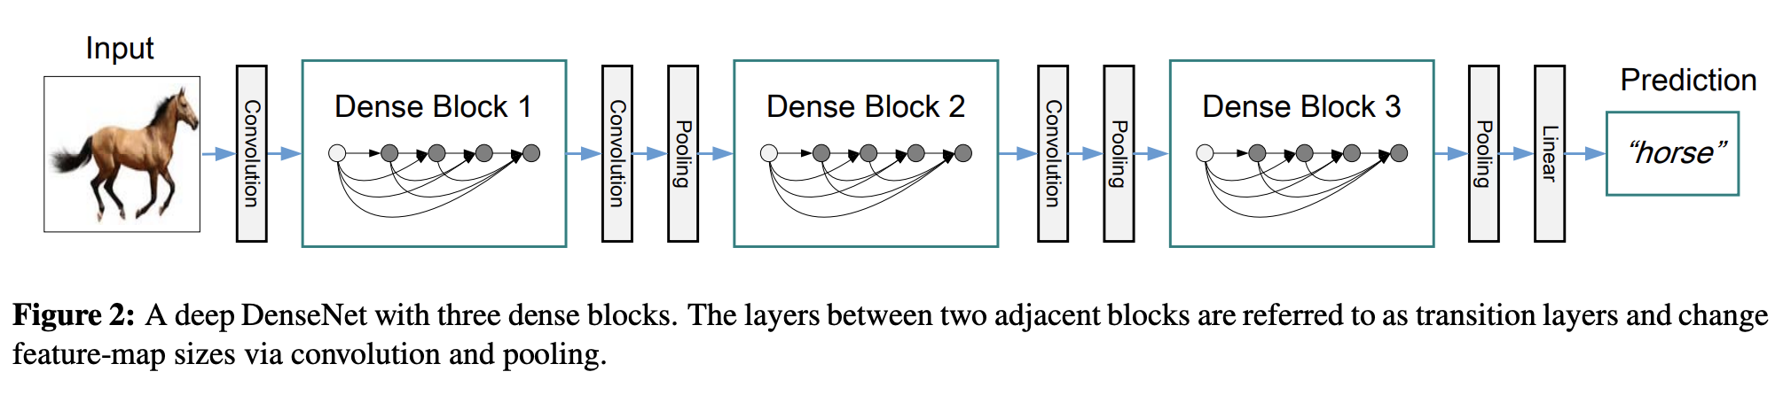
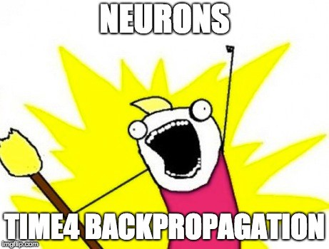
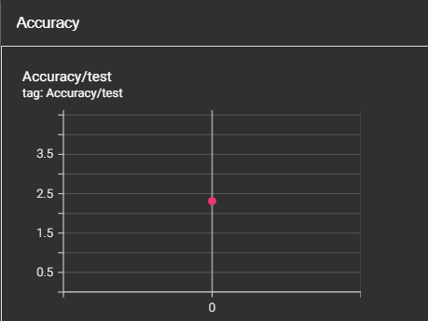
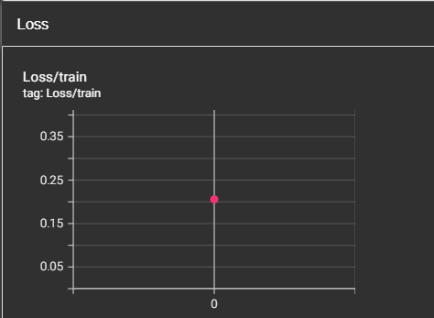
DenseNet
Strengthening feature propagation
https://towardsdatascience.com/densenet-2810936aeebb

Slide 12
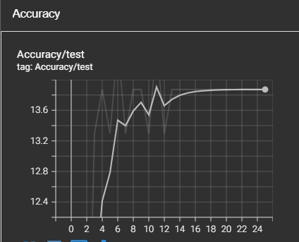
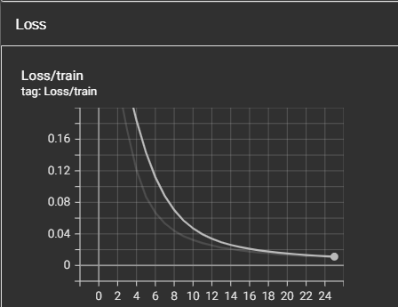
GoogLeNet
22 layers deep network, specifically for classification and object detection.
Reached an accuracy of approximately 14.85 % at 11 epochs.

Slide 13
Hyperparameters & Data

Slide 14
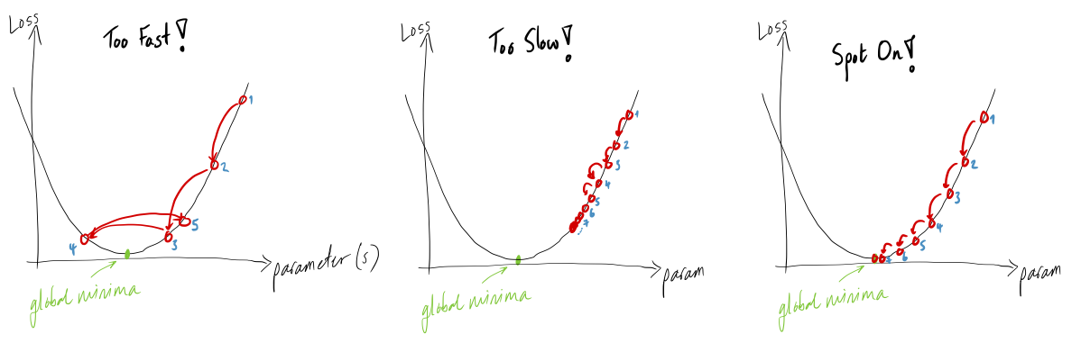
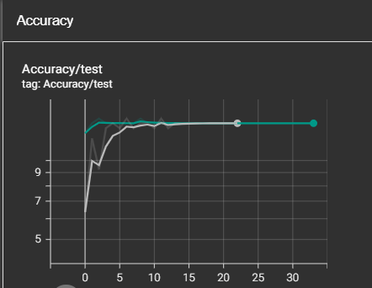
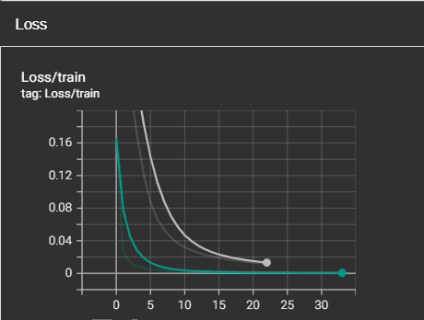
Learning Rates
Learning rates affect how fast the algorithm learns, and to what extent the cost function is minimized.
We tested different learning rates on each of our models to try and find the most optimal one.
Lr = 0.00001 ..
Lr = 0.000001

Slide 15
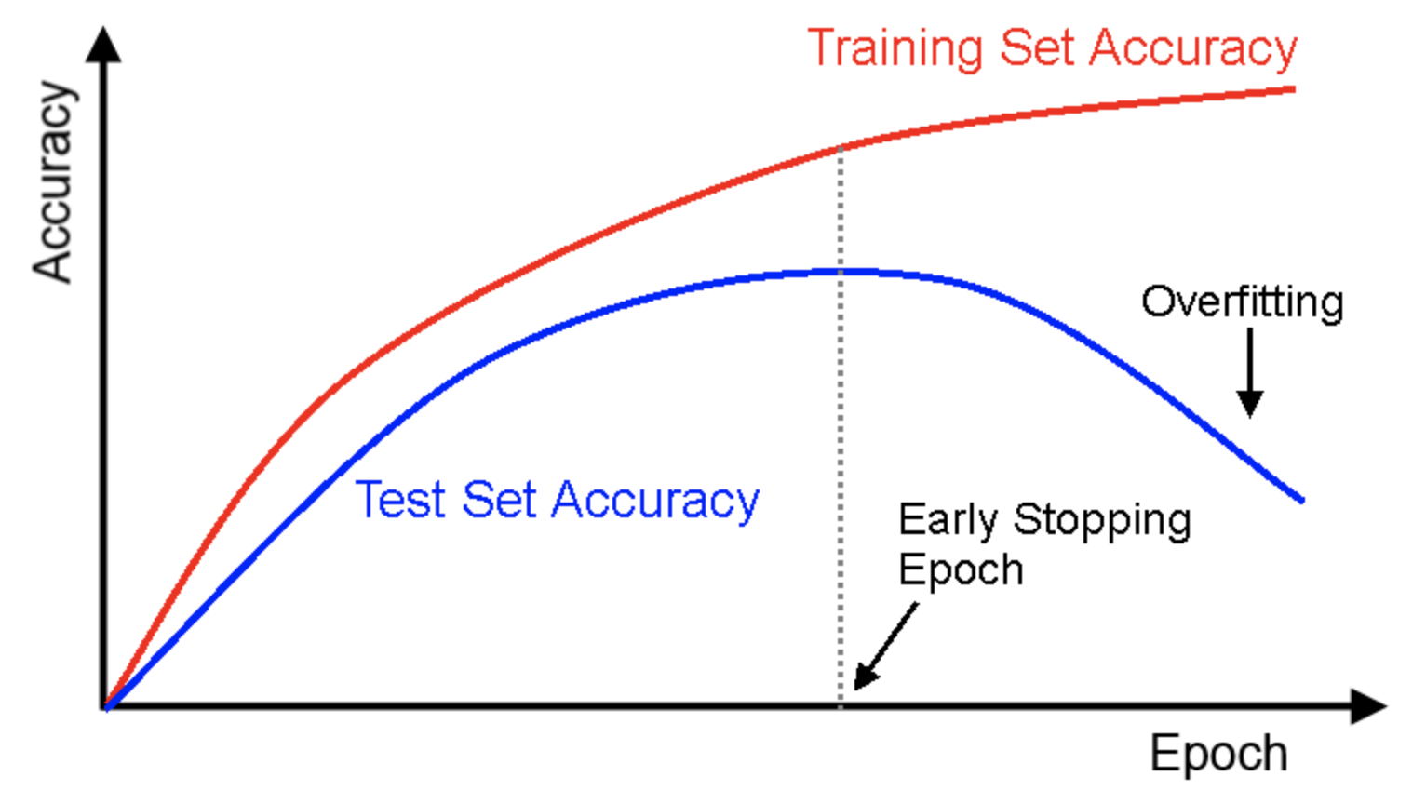
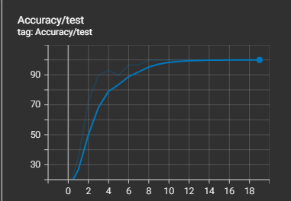
Epochs
The number of times we iterate through the data
Why does it matter?
https://datascience.stackexchange.com/questions/32306/in-which-epoch-should-i-stop-the-training-to-avoid-overfitting

Slide 16
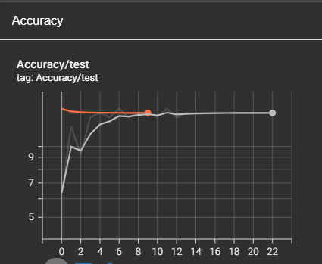
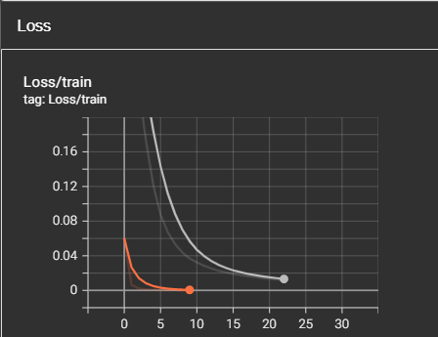
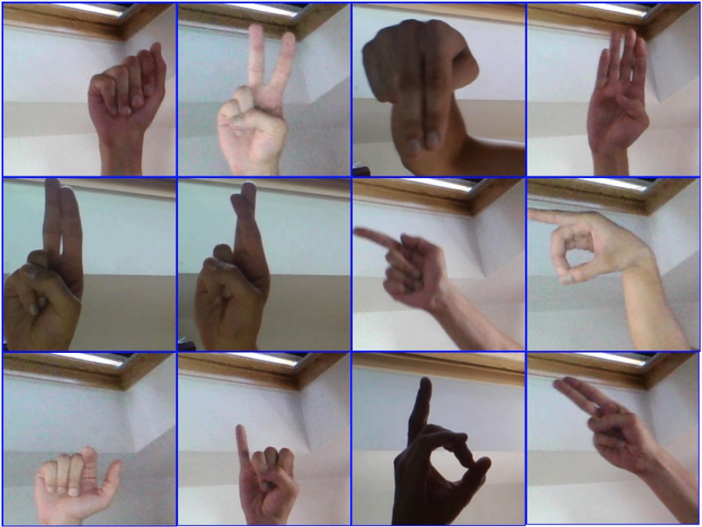
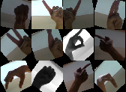
Data Augmentation
Non-Augmented
Augmented ….....
Augmentations Applied:
Grey-Scale
Color-Jitter
Horizontal, Vertical, & Random Rotations
Not much of a difference in our results.

Slide 17
Takeaways

Slide 18
Findings
We found GoogLeNet to be the best model.
GoogLeNet was able to achieve an accuracy of 14%.
In comparison, the Simple Classifier reached 7% and DenseNet reached 2.3%

Slide 19
Challenges
Limited knowledge about AI and ML.
Problems with Skynet and Jupyter notebooks.
Skewed accuracy based on limited test sets.
Running the models was very time-consuming.

Slide 20
Future Applications & Improvements
Fine tuning and running more tests to improve accuracy.
Increase the number of hand signs our model can identify, including dynamic signs.
Create an app or website to use as a translator with a live camera.

Slide 21
Thank you!

